Slide 1
Tutorial 04
Creating a Graphic Design for a Genealogy Website

Slide 2
Objectives
Create a figure box
Add a background image
Add a border to an element
Create rounded borders
Create a graphic border
Create a text shadow

Slide 3
Objectives (continued)
Create a box shadow
Create linear and radial gradients
Set the opacity of an element
Apply a 2D and 3D transformation
Apply a CSS filter
Create an image map

Slide 4
Creating Figure Boxes
figure and figcaption elements:
  They are used by HTML5 to introduce structural elements
  The figcaption element is optional
  The figcaption element can be placed directly before or after a figure box content

Slide 5
Creating Figure Boxes (continued 1)
General syntax to create a figure box:
<figure>
content
<figcaption>caption text</figcaption>
</figure>
where content is the content appearing in a figure box and caption text is the description text that accompanies the figure

Slide 6
Creating Figure Boxes (continued 2)
The figure element is used to mark a page content that should stand apart from the main content

Slide 7
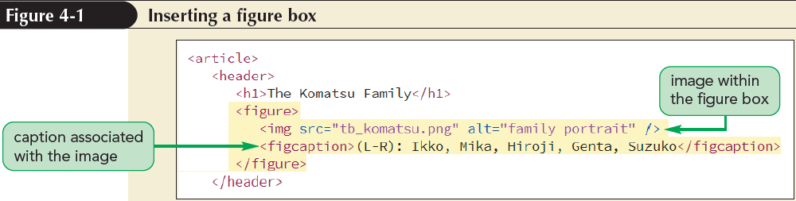
Creating Figure Boxes (continued 3)

Slide 8
Exploring Background Styles
The use of images for backgrounds is supported by CSS using the following background-image style:
background-image: url(url);
where url specifies the name and location of the background image

Slide 9
Tiling a Background Image
Tiling is the process of repeating an image both vertically and horizontally until the background is filled
The type of tiling can be specified by applying the following background-repeat style:
background-repeat: type;
where type can be repeat (the default), repeat-x, repeat-y, round, or space

Slide 10
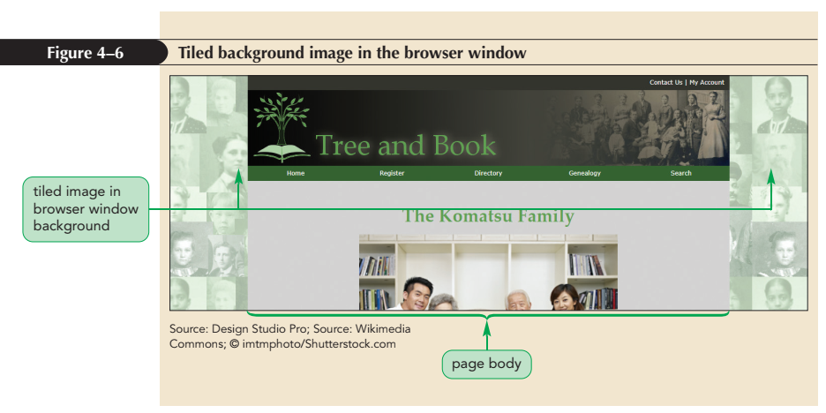
Tiling a Background Image (continued)

Slide 11
Attaching the Background Image
A background image is attached to its element so that it scrolls when the element content is scrolled
The attachment can be changed using the following property:
    background-attachment: type;
    where type is scroll (the default), fixed, or local

Slide 12
Attaching the Background Image (continued 1)
type in the background-attachment property:
  scroll sets the background to scroll with the element content
  fixed creates a background that stays in place even as the element content is scrolled
  local allows the element background to scroll along with the content within the box

Slide 13
Attaching the Background Image (continued 2)
Watermarks are translucent graphics displayed behind a content
They can be created using fixed backgrounds
They are often used to indicate that a content material is copyrighted

Slide 14
Setting the Background Image Position
By default, background images are placed in an element’s top-left corner
The following property can be used to set the position of a background image:
background-position: horizontal vertical;
where horizontal and vertical provide the coordinates of an image within the element background

Slide 15
Setting the Background Image Position (continued)
Keywords to position a background image are as follows:
  left, center, and right are used to position the background horizontally
  top, center, and bottom are used to position the background vertically
The background-position property is only useful for non-tiled images

Slide 16
Defining the Extent of the Background
An element’s background extends only through the padding space excluding the border space
This can be changed using the following property:
background-clip: type;

Slide 17
Defining the Extent of the Background (continued)
type in the background-clip property:
  content-box extends the background only through the element content
  padding-box extends the background through the padding space
  border-box extends the background through the border space

Slide 18
Sizing and Clipping an Image
By default, the size of a background image equals the size stored in its image file
This size can be changed by using the following property:
  background-size: width height;
  where width and height can be specified in pixels or by using the keywords auto, cover, and contain

Slide 19
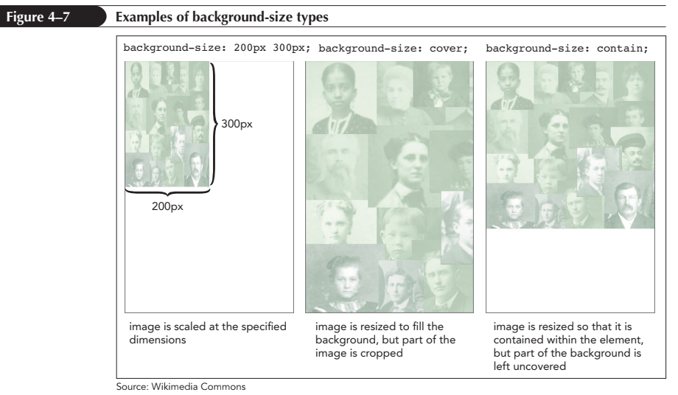
Sizing and Clipping an Image (continued)

Slide 20
The background Property
Different background options can be organized using the following property:
background: color url(url) position/size repeat attachment origin clip;
where color is the background color, url is the source of the background image, and position is the image’s position

Slide 21
The background Property (continued)
size sets the image size
repeat sets the tiling of the image
attachment specifies whether the image scrolls with the content or is fixed
origin defines how positions are measured on the background
clip specifies the extent over which the background is spread

Slide 22
Adding Multiple Backgrounds
Multiple backgrounds can be added to a single element by listing the backgrounds in the following comma-separated list:
background: background1, background2, …;

Slide 23
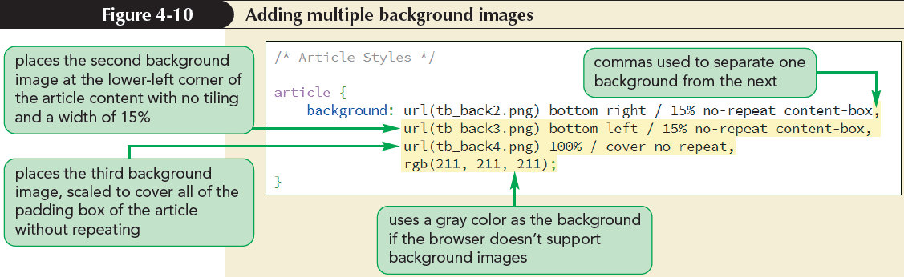
Adding Multiple Backgrounds (continued)

Slide 24
Setting Border Width and Color
There are several style properties that can be used to format the border around each element using CSS
To define the thickness of a specific border, the following property can be used:
border-side-width: width;
where side is either top, right, bottom, or left and width is the width of the border in one of the CSS units of measure

Slide 25
Setting the Border Design
The appearance of borders can be further defined by using the following style:
border-side-style: style;
where side in indicates the border side and style specifies one of the nine border styles

Slide 26
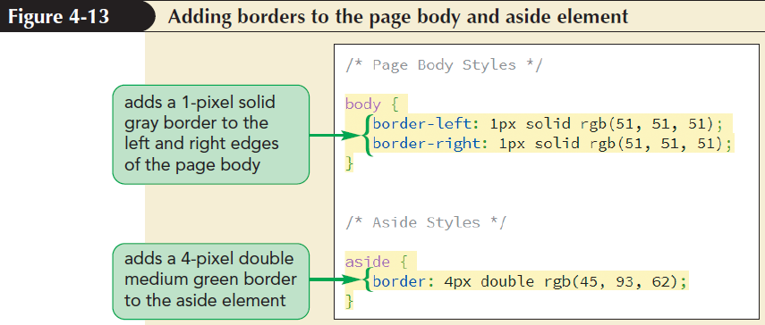
Setting the Border Design
(continued)

Slide 27
Creating Rounded Corners
Any of the four corners of a border can be rounded off by applying the following property:
border-radius: top-left top-right bottom-right bottom-left;
where top-left, top-right, bottom-right, and bottom-left are the radii of the individual corners

Slide 28
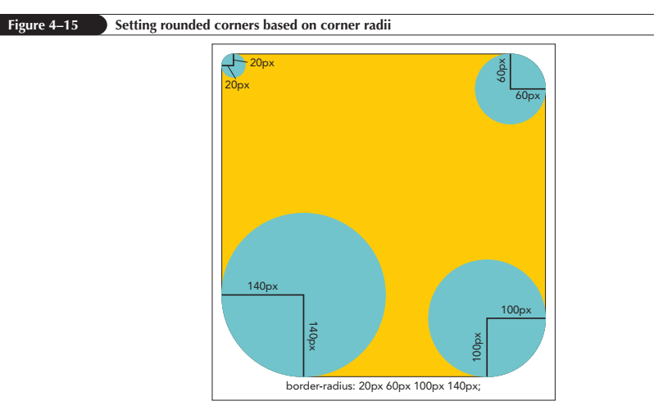
Creating Rounded Corners
(continued 1)

Slide 29
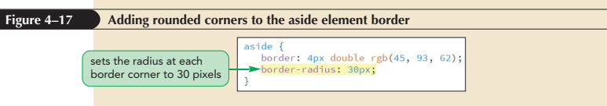
Creating Rounded Corners
(continued 2)

Slide 30
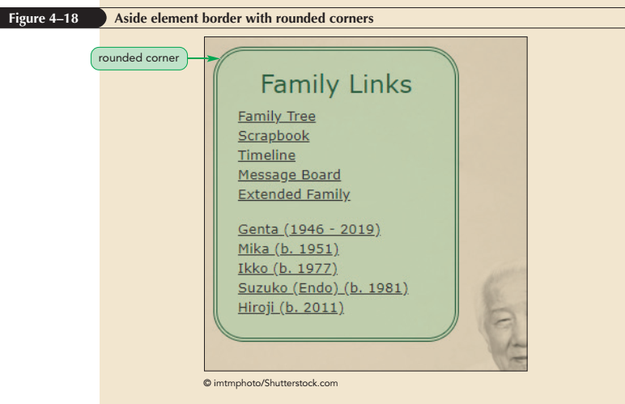
Creating Rounded Corners
(continued 3)

Slide 31
Applying a Border Image
A border image is a border based on a graphic image
The graphic image is sliced into nine sections representing the four corners, the four sides, and the interior piece
The content of the object appears in the interior piece and this piece is discarded

Slide 32
Applying a Border Image
(continued 1)
The four corners become the corners of the border
The four sides are either stretched or tiled to fill in the border’s top, right, bottom, and left sides

Slide 33
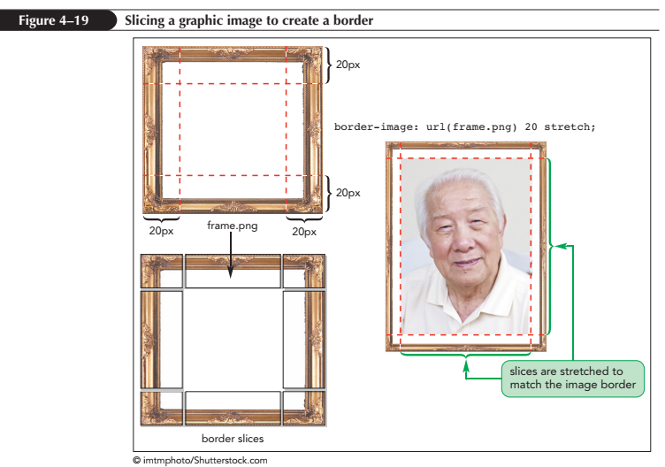
Applying a Border Image
(continued 2)

Slide 34
Applying a Border Image
(continued 3)
Border image uses the following property:
border-image: url(url) slice repeat fill;
where url is the source of the graphic image, slice is the width or height of the slices used to create the sides and corners, repeat indicates whether the side slices should be stretched or tiled to cover the border’s four sides, and fill is an optional attribute that fills the image background with the graphic image file

Slide 35
Applying a Border Image
(continued 4)
The repeat option supports:
  stretch: slices are stretched to fill each side
  repeat: slices are tiled to fill each side
  round: when the slices are tiled to fill each side, if they do not fill the sides with an integer number of tiles, the slices are rescaled until they do
  space: when the slices are tiled to fill each side, if they do not fill the sides with an integer number of tiles, extra space is distributed around the tiles

Slide 36
Creating a Text Shadow
To give the text on a page visual impact, use CSS to add a shadow using the following text-shadow property:
text-shadow: color offsetX offsetY blur;
  where color is the shadow color, offsetX and offsetY are the distances of the shadow from the text in the horizontal and vertical directions, and blur defines the amount by which the shadow spreads out, creating a blurred effect

Slide 37
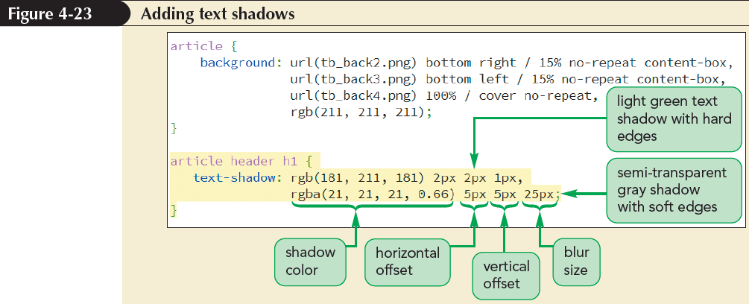
Creating a Text Shadow (continued)

Slide 38
Creating a Box Shadow
Any block element can be shadowed by using the box-shadow property
    box-shadow: color offsetX offsetY blur;
    where color, offsetX, offsetY, and blur have the same meanings for box shadows as they do for text shadows
Multiple shadows can be added by including them in a comma-separated list

Slide 39
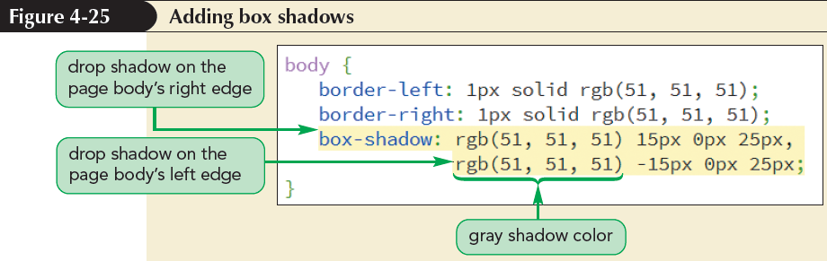
Creating a Box Shadow (continued 1)

Slide 40
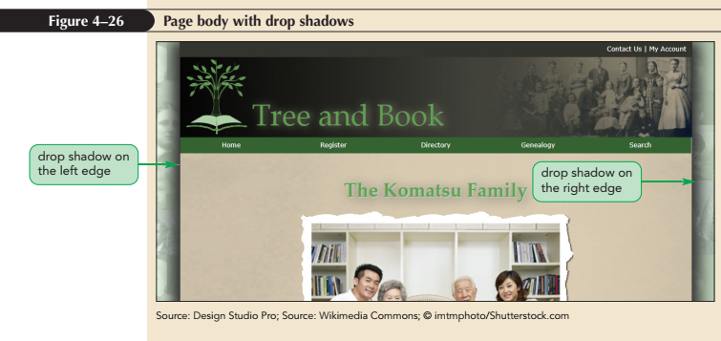
Creating a Box Shadow (continued 2)

Slide 41
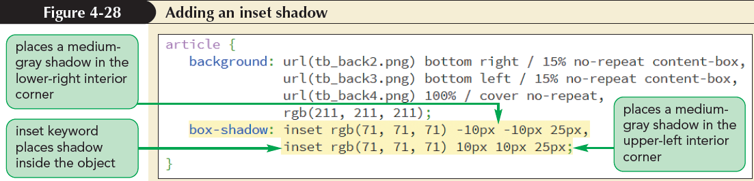
Creating a Box Shadow (continued 3)

Slide 42
Applying a Color Gradient
Color gradient:
  One color gradually blends into another color or fades away if transparent colors are used
  It can be used to modify a background color

Slide 43
Creating a Linear Gradient
A linear gradient is a color gradient in which the background color transitions from a starting color to an ending color along a straight line
Linear gradients are created using the linear-gradient function:
linear-gradient(color1, color2, …)
where color1, color2, and so on are the colors that blend into one another starting from color1, through color2, and onto the last color listed

Slide 44
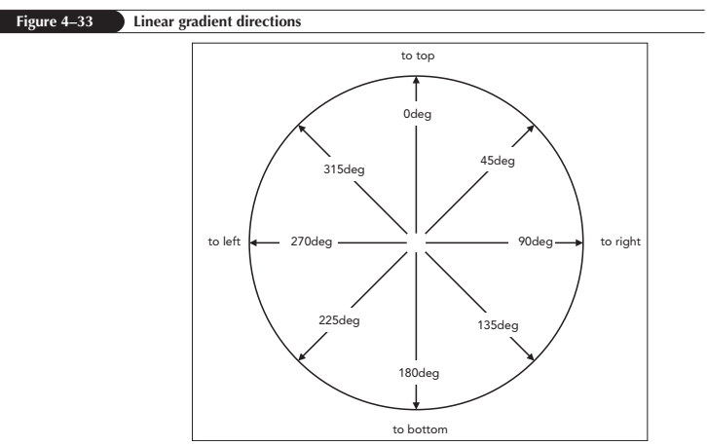
Creating a Linear Gradient (continued)

Slide 45
Gradients and Color Stops
The colors specified in a gradient are evenly distributed
The following gradient starts with a solid red, solid green appears halfway through the gradient, and finishes with solid blue:
    background: linear-gradient(red, green, blue)

Slide 46
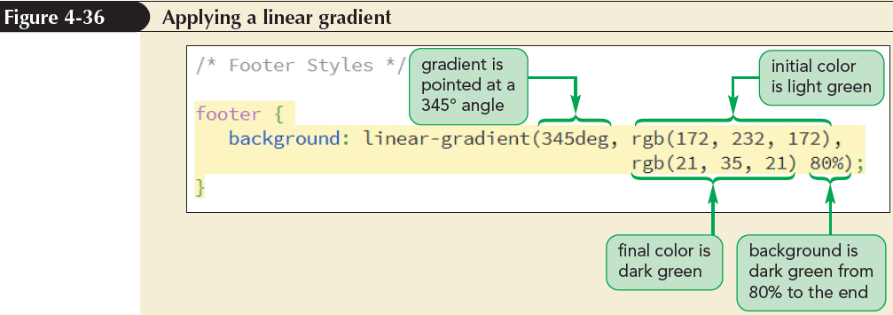
Gradients and Color Stops (continued)

Slide 47
Creating a Radial Gradient
A radial gradient is a color gradient that starts from a central point and proceeds outward in a series of concentric circles or ellipses
Radial gradients are created using:
radial-gradient(shape size at position, color-stop1, color-stop2, …)

Slide 48
Creating a Radial Gradient
(continued 1)
The shape value defines the shape of the gradient and is either ellipse (default) or circle
The size value defines the extent of the gradient as it radiates outward and can be expressed with a CSS unit of measure, a percentage of the background’s width and height, or with one of the following keywords:

Slide 49
Creating a Radial Gradient
(continued 2)
  farthest-corner (default): Gradient extends to the background corner farthest from the gradient’s center
  farthest-side: Gradient extends to background side farthest from the gradient’s center
  closest-corner: Gradient extends to the nearest background corner
  closest-side: Gradient extends to the background side closest to the gradient’s center

Slide 50
Creating a Radial Gradient
(continued 3)
The position defines where the gradient radiates from and can be expressed in coordinates using pixels, percentages of the element’s width and height, or with the keywords: left, center, right, top, and bottom
The default is to place the gradient within the center of the background

Slide 51
Creating a Radial Gradient
(continued 4)
The color-stop1, color-stop2 … values are the colors and their stopping positions within the gradient and have the same interpretation used for linear gradients except they mark stopping points as the gradient radiates outward
The color stops are optional, just as they are in linear gradients

Slide 52
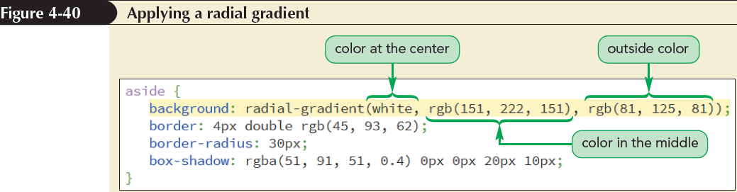
Creating a Radial Gradient
(continued 5)

Slide 53
Repeating a Gradient
A gradient design can be repeated to avoid the gradient function from being complicated due to the addition of more color stops
    repeating-linear-gradient(params)
    repeating-radial-gradient(params)
    where params are the parameters of the linear-gradient or the radial-gradient functions

Slide 54
Creating Semi-Transparent Objects
Semi-Transparent colors can be created using the following opacity property:
opacity: value;
where value ranges from 0 (completely transparent) up to 1 (completely opaque)

Slide 55
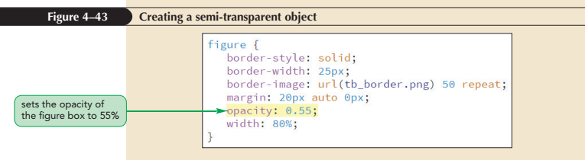
Creating Semi-Transparent Objects (continued 1)

Slide 56
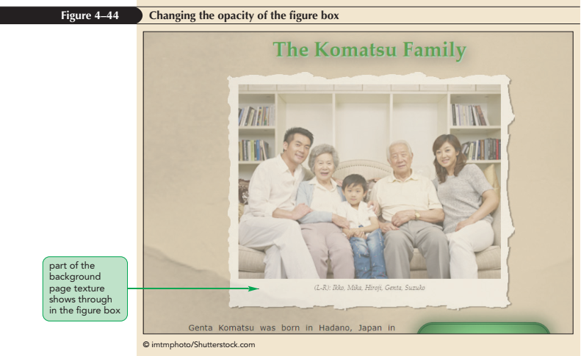
Creating Semi-Transparent Objects (continued 2)

Slide 57
Transforming Page Objects
Rotation, rescaling, and translation in space can be used to transform the appearance of page objects
transform: effect(params);
where effect is the transformation function that will be applied to page objects and params specify the parameters required by the transformation function

Slide 58
Transforming Page Objects (continued 1)
Function | Description
translate(offX, offY) | Moves the object offX pixels to the right and offY pixels down; negative values move the object to the left and up
translateX(offX) | Moves the object offX pixels to the right; negative values move the object to the left
translateY(offY) | Moves the object offY pixels down; negative values move the object up
scale(x, y) | Resizes the object by a factor of x horizontally and a factor of y vertically
scaleX(x) | Resizes the object by a factor of x horizontally
scaleY(y) | Resizes the object by a factor of y vertically
skew(angleX, angleY) | Skews the object by angleX degrees horizontally and angleY degrees vertically
skewX(angleX) | Skews the object by angleX degrees horizontally
skewY(angleY) | Skews the object by angleY degrees vertically
rotate(angle) | Rotates the object by angle degrees clockwise; negative values rotate the object counter-clockwise
matrix(n, n, n, n, n, n) | Applies a 2D transformation based on a matrix of six values

Slide 59
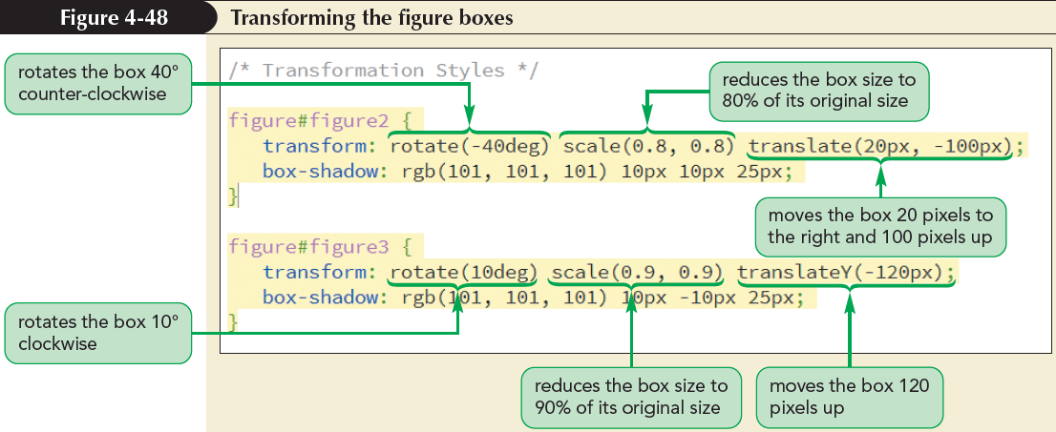
Transforming Page Objects (continued 2)

Slide 60
Transformations in Three Dimensions
A 3D transformation is a change that involves three spatial axes:
  an x-axis that runs horizontally across the page
  a y-axis that runs vertically
  a z-axis that comes straight out of the page toward and away from the viewer

Slide 61
Transformations in Three Dimensions (continued)
Function | Description
translate3d(offX, offY, offZ) | Shifts the object offX pixels horizontally, offY pixels vertically, and offZ pixels along the z-axis
translateX(offX) translateY(offY) translateZ(offZ) | Shifts the object offX, offY, or offZ pixels along the specified axis
rotate3d(x, y, z, angle) | Rotates the object around the three-dimensional vector (x, y, z) at a direction of angle
rotateX(angle) rotateY(angle) rotateZ(angle) | Rotates the object around the specified axis at a direction of angle
scale3d(x, y, z) | Resizes the object by a factor of x horizontally, a factor of y vertically, and a factor of z along the z-axis
scaleX(x) scaleY(y) scaleZ(z) | Resizes the object by a factor of x, y, or z along the specified axis
perspective(p) | Sets the size of the perspective effect to p
matrix3d(n, n, …, n) | Applies a 3D transformation based on a matrix of 16 values

Slide 62
Understanding Perspective
Perspective is a measure of how rapidly objects appear to recede from the viewer in a 3D space
Perspective can be thought in terms of a pair of railroad tracks that appear to converge at a point, known as the vanishing point

Slide 63
Understanding Perspective (continued 1)
The perspective of a 3D space can be defined using
perspective: value;
where value is a positive value that measures the strength of the perspective effect
Lower value results in more extreme distortion

Slide 64
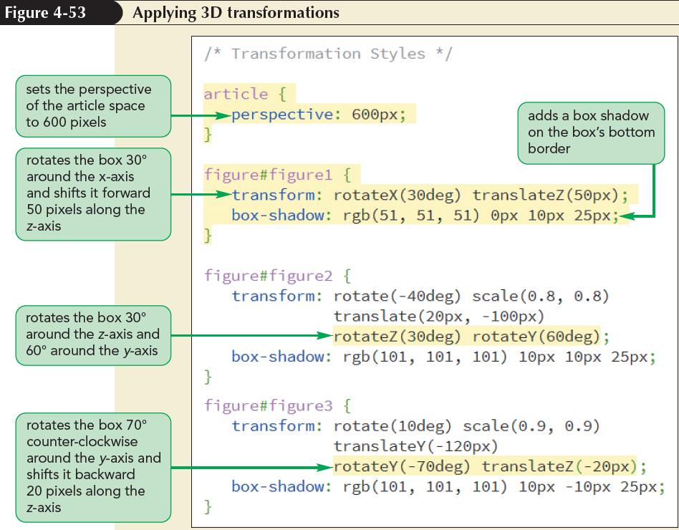
Understanding Perspective (continued 2)

Slide 65
Exploring CSS Filters
Filters adjust how a browser renders an image, a background, or a border
Filters modify an object’s color, brightness, contrast, or general appearance
Filters can be applied using the following property:
filter: effect(params);
where effect is a filter function and params specify the parameters of filter function

Slide 66
Exploring CSS Filters (continued 2)
Function | Description
blur(length) | Applies a blur to the image where length defines the size of blur in pixels
brightness(value) | Adjusts the brightness where values from 0 to 1 decrease the brightness and values greater than 1 increase the brightness
contrast(value) | Adjusts the contrast where values from 0 to 1 decrease the contrast and values greater than 1 increase the contrast
drop-shadow(offsetX offsetY blur color) | Adds a drop shadow to the image where offsetX and offsetY are horizontal and vertical distances of the shadow, blur is the shadow blurring, and color is the shadow color
grayscale(value) | Displays the image in grayscale from 0, leaving the image unchanged, up to 1, displaying the image in complete grayscale
hue-rotate(angle) | Adjusts the hue by angle in the color wheel where 0deg leaves the hue unchanged, 180deg displays the complimentary colors and 360deg again leaves the hue unchanged
invert(value) | Inverts the color from 0 (leaving the image unchanged), up to 1 (completely inverting the colors)
opacity(value) | Applies transparency to the image from 0 (making the image transparent), up to 1 (leaving the image opaque)
saturate(value) | Adjusts the color saturation where values from 0 to 1 decrease the saturation and values greater than 1 increase the saturation
sepia(value) | Displays the color in a sepia tone from 0 (leaving the image unchanged), up to 1 (image completely in sepia)
url(url) | Loads an SVG filter file from url

Slide 67
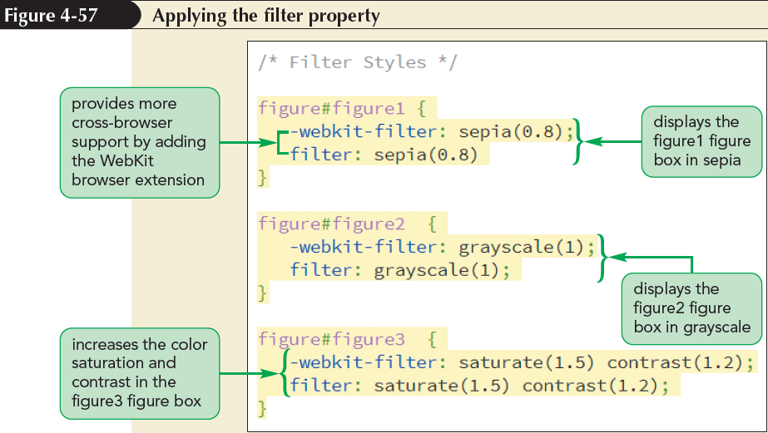
Exploring CSS Filters (continued 3)

Slide 68
Working with Image Maps
With HTML an image can be divided into different zones, or hotspots
Hotspots can then be linked to different URLs through information provided in an image map

Slide 69
Working with Image Maps (continued)
A client-side image map is an image map that is defined within the web page and handled entirely by the web browser
A server-side image map relies on a program running on the web server to create and administer the map

Slide 70
Defining a Client-Side Image Map
Client-side image maps are defined with the following map element:
<map name=“text”>
hotspots
</map>
where text is the name of the image map and hotspots are the defined regions within an image that are linked to different URLs

Slide 71
Defining a Client-Side Image Map (continued 1)
Client-side image maps:
  Can be placed anywhere within the body of a web page
  They are not actually displayed by browsers
  They are simply used as references for mapping the locations of the hotspots within the image
The most common practice is to place a map element below the corresponding inline image

Slide 72
Defining a Client-Side Image Map (continued 2)
Each hotspot within the map element is defined using the following area element:
<area shape="shape" coords="coordinates"
href="url" alt="text" />
where shape is the shape of the hotspot region, coordinates are the list of points defining the boundaries of that region, url is the URL of the hypertext link, and text is alternate text displayed for non-graphical browsers

Slide 73
Defining a Client-Side Image Map (continued 3)
Hotspots can be created as rectangles, circles, or polygons (multisided figures) using shape values of rect, circle, and poly respectively
A fourth possible shape value, default, represents the remaining area of the inline image not covered by any hotspots
There is no limit to the number of hotspots that can be added to an image map

Slide 74
Defining a Client-Side Image Map (continued 4)
For rectangular hotspots, the shape and coords attributes have the general form:
shape="rect" coords="left,top,right,bottom"
where left, top are the coordinates of the top-left corner of the rectangle and right, bottom are the coordinates of the bottom-right corner

Slide 75
Defining a Client-Side Image Map (continued 5)
Circular hotspots are defined using the attributes:
shape=“circle” coords=“x, y, radius”
where x and y are the coordinates of the center of the circle and radius is the circle’s radius

Slide 76
Defining a Client-Side Image Map (continued 6)
Polygonal hotspots have the attributes:
shape="poly" coords="x1,y1,x2,y2,…"
where (x1, y1), (x2, y2), … set the coordinates of each vertex in the shape
To define the default hotspot for an image, create the following hotspot:
shape="default" coords="0,0,width,height“
where width is the width of the image in pixels and height is the image’s height

Slide 77
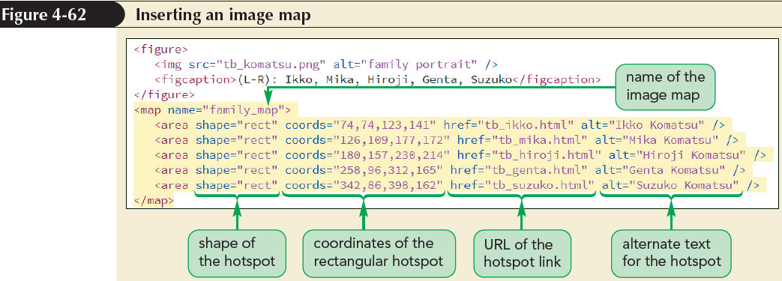
Defining a Client-Side Image Map (continued 7)

Slide 78
Applying an Image Map
An image map can be applied to an image using the following usemap attribute to the img element:
<img src=“url” alt=“text” usemap=“#map” />
where map is the name assigned to the image map within the current HTML file

Slide 79
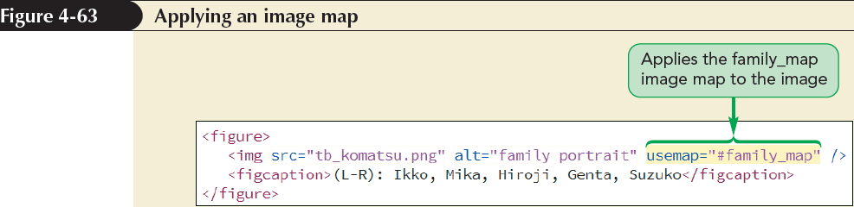
Applying an Image Map (continued)

